Slide 1











Notes:
DO NOT UNHIDE THIS SLIDE. There is an action button on the title slide to activate the waiting slide.
Waiting Slide. This is the slide displayed until everyone is ready for the presentation. Use it as a background to do some small talk, roundtable, wait for participants to arrive.
TO START THE PRESENTATION, click esc.

Slide 2
Incident management
Starter Pack Training Material
Notes:
Click on the Apptio Logo to launch the hidden Waiting Slide.

Slide 3
AGENDA
ITIL Incident Management
ServiceNow Overview
Incident Handling
Additional Functionalities
Exercises

Slide 4
ITIL Incident Management

Slide 5
INCIDENT MANAGEMENT PROCESS
Incident definition:
Any event which is not part of standard operations that causes, or may cause, an interruption to, or reduction in, the quality of service
can be a failure or a request
is generally handled by the Service Desk
Objective:
To restore normal service operation as quickly as possible and minimize the adverse impact on business operations, thus ensuring that agreed levels of service quality are maintained
For failures: to restore the normal service as quickly as possible
For requests: to fulfill user’s request as quickly as possible
Notes:
‘Normal service operation’ is defined as an operational state where services and CIs are performing within their agreed service and operational levels.

Slide 6
INCIDENT MANAGEMENT PROCESS FLOW (1/2)
Event
Management
Web Interface
Phone Call
Email
Incident
Identification
Standardized Service Request?
yes
Request Fulfillment
no
Incident Logging
Incident Categorization
Incident Prioritization
Source: ITIL2011

Slide 7
INCIDENT MANAGEMENT PROCESS FLOW (2/2)
Initial
Diagnosis
Functional Escalation
yes
Functional Escalation?
yes
Ecalation Needed?
no
no
Hierarchical Escalation?
Management Escalation
yes
no
Investigation & Diagnosis
Resolution Identified?
no
yes
Resolution & Recovery
Incident Closure
END
Source: ITIL2011

Slide 8
Servicenow overview

Slide 9
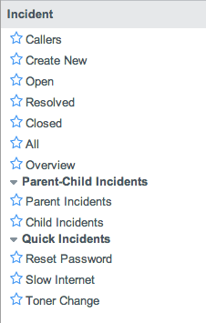
APPLICATIONS & MODULES
Lists all users
Opens a blank incident creation form
Lists open incidents¹
Lists resolved incidents
Lists inactive incidents (Status = “Closed”)
Lists all incidents
Opens incident overview page (dashboard)
Lists active parent and child incidents resp.
To open standardized incidents creation forms
1
2
3
4
5
6
7
8
9
¹ Status = “New”, “In progress”, or “Awaiting”

Slide 10
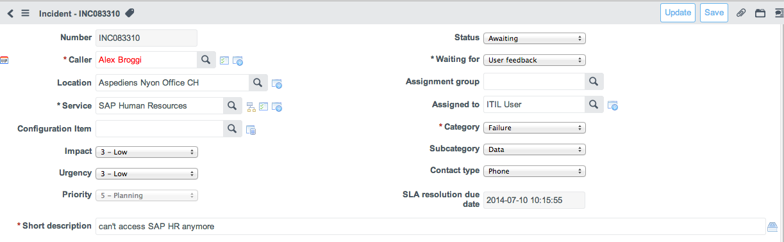
FORM & FIELDS
1
6
2
7
3
8
4
9
5
10
11
Orange = automated fields
Number (unique reference)
User & his/her Location
Service & CI (Configuration Item) Impacted
Impact (business) & Urgency (resolution)
Priority (based on Impact x Urgency matrix)
Status (indicates resolution progress)
Assignment group & responsible member
Category & Subcategory
Channel used to report the incident
Closed resolution date/time target (as per Task SLM)
Short description (keywords)

Slide 11
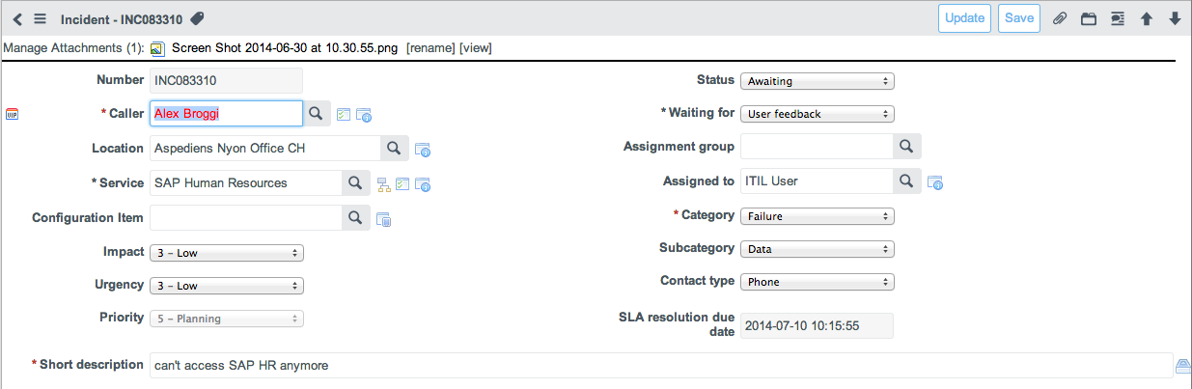


ACTION BUTTONS
1
2
3
4
5
Save the incident and go back to the list
Save the incident and remain on the current form
Add attachment to the record
Navigate to previous/next record in the list
Attachments and their management
Lookup record list (e.g. users or groups)
Show related records (e.g. from same caller)
Show service/CI map
Show caller’s CIs
Show reference record details (hover)
Navigate to reference record (click)
Search KB with short description as keywords

Slide 12
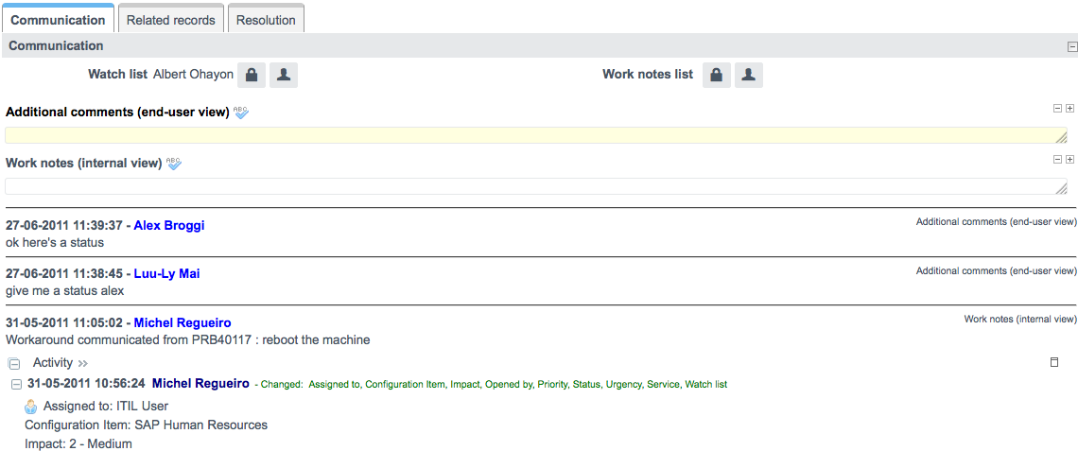
COMMUNICATION SECTION
1
2
3
4
5
People who can follow the incident
People who are notified when work notes are added
Additional comments to communicate with the caller
Work notes for internal information exchange
Audit trail of the incident record
Spell checker
Increase/decrease text area
Display/hide info. on Activity field

Slide 13
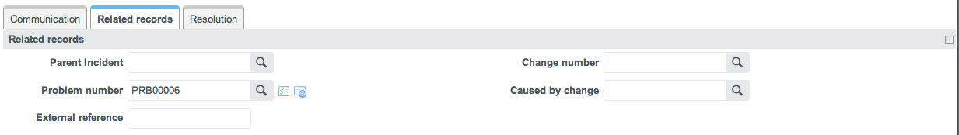
Related records SECTION
1
4
2
5
3
Relation to Parent Incident record
Relation to Problem record
External reference number, e.g. supplier ticketing system’s number
Relation to change record
Relation to change that caused the incident

Slide 14
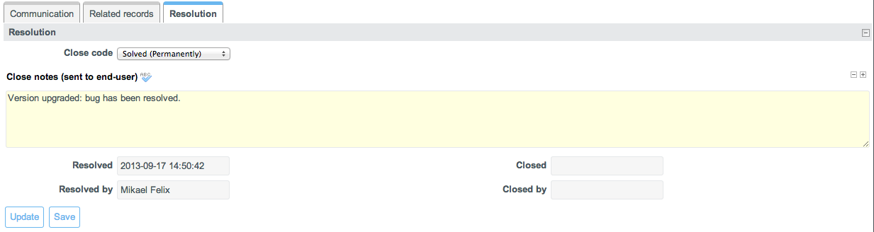
Resolution SECTION
1
2
3
5
4
6
Close codes:
Solved (Permanently)
Solved (Work Around)
Not Solved (Not Reproducible)
Not Solved (Too Costly)
Cancelled by Caller
Misplaced Call
Close notes (user-friendly description)
Resolution date
User that resolved the incident
Closure date
User that closed the incident
Orange = automated fields

Slide 15
Incident HANDLING

Slide 16
INCIDENT LIFECYCLE
1. Creation
2. Initial Diagnosis
3. Functional Escalation
4. Investigation & Diagnosis
5. Resolution & Recovery
6. Closure

Slide 17
1. CREATION
Step | In ServiceNow
Create an incident | "Incident" > "Create New”.
Select the caller | In the "Caller" field, search for the impacted user name.
Select the Service impacted¹ | In the “Service” field search for the service that is impacted
Select CI affected¹ | If identified at this point, select the appropriate CI (use “Show CI Map” icon next to “Service” as a guide).
Select the appropriate impact and urgency | Select the impact and urgency. Priority will be calculated automatically.
Select the appropriate category and subcategory | Select the relevant choices in the appropriate fields.
Identify how the issue was reported | Select the appropriate choice in the "Contact type" field.
Enter a meaningful short description | Update the "Short description" field.
Document the issue as described by the caller | Enter the full issue details (e-mail content or phone conversation) in “Additional comments” field.
Add other people to be included in automatic updates | Add users or e-mail addresses to the ‘Watch list” as required. Users added will receive the same notifications as the caller and can view the incident in the self-service portal.
Save the incident | Click on “Update” or “Save”
¹ If an outage exists for the Service or CI, the field content is colored in red and a message is displayed.
Ref.: Additional Functionalities – Outage Detection.

Slide 18
SERVICES (Sample)
Service | Description
Application Services | Provides all central business applications used to support the business such as ERP, SFA, etc.
Email Services | Provides all email communications including Blackberry, iPhone, etc.
Infrastructure Services | Provides servers, storage area network, UPS, etc.
Network Services | Provides all infrastructure components that support global, local and remote connectivity.
Printing Services | Provides all printing devices including local and network printers, plotters, copy machines, etc.
Telephony Services | Provides voice or fax communication.
Workplace Services | Provides end-users workstation with hardware, OS and software. Software covers installed software only. Centrally provided software such as ERP, CRM are covered in Business Applications.

Slide 19
INCIDENT CATEGORIZATION (1/2)
Failure
Any event which is not part of standard operations that causes, or may cause, an interruption to, or reduction in, the quality of service.
Resolution objective: To restore normal service operation as quickly as possible and minimize the adverse impact on business operations, thus ensuring that agreed levels of service quality are maintained.
Request
Any incoming request that does not deal with a failure.
Resolution objective: to provide requested service to the user.
Customer Feedback
Any complaint or compliment received from the user.
Record objective: record customer feedback for continuous improvements.
Misplaced Call
Any incoming request out of the scope.
Record objective: recording incoming requests for further analysis.

Slide 20
INCIDENT CATEGORIZATION (2/2)
Category | Sub-category | Description/Examples
Failure | Connectivity | Issue with network such as LAN, WAN, etc.
 | Data | Data integrity, missing, corrupted. e.g. incorrect data load
 | Facilities | e.g. power generator down, Air Conditioning down
 | Hardware | Hardware failure e.g. computer monitor does not turn on
 | Security | e.g. Denial of service attack, virus, etc.
 | Software | Software bug, etc.
Request | Request for Change | Request to modify an application/component or service.
 | Request for Info | “How to” type of questions
 | Request for Work | e.g. Password reset, new user creation, restore workstation back-up, etc.
Customer Feedback¹ | Complaint
 | Compliment
Misplaced Call¹
¹ If Customer Feedback or Misplaced call is selected as a category, the appropriate close code is automatically selected.

Slide 21
INCIDENT PRIORITIZATION (1/2)
Impact
defines the extent of the business impact:
1 – High: Severe impact; All users are impacted
2 – Medium: Significant impact; More than one user is impacted
3 – Low: Isolated impact; No, or one, user is impacted
Urgency
defines the business’ tolerance to live with the impact:
1 – High: Productivity is totally blocked
2 – Medium: Productivity is partially blocked
3 – Low: Productivity not blocked

Slide 22
INCIDENT PRIORITIZATION (2/2)
Impact x Urgency matrix to calculate Priority:
1 – High | 3 | 2 | 1
2 – Medium | 4 | 3 | 2
3 – Low | 5 | 4 | 3
 | 3 – Low | 2 – Medium | 1 – High
Impact
Urgency

Slide 23
INCIDENT STATUSES
Status | Description
New | Default status for new incidents.
In progress | Incident is assigned and resolution is in progress.
Awaiting | Incident is being investigated and is awaiting for another event e.g. change implementation, problem resolution, user or supplier feedback.
Resolved | Incident is resolved. Incident will auto-close after 5 days unless it’s reopened by the caller.
Closed | Incident considered definitely resolved (after the given timeframe for validation/feedback).

Slide 24
2. INITIAL DIAGNOSIS
Step | In ServiceNow
Take ownership of the incident and update the incident status | Add your name in “Assigned to”. Change status field to “In progress” and save the record.
Perform the initial diagnosis | To help you in this task, you can: Search the knowledge base Look at similar incident on the Service or the CI Use CI Map Look at open problems or known errors Document the work performed and your findings in “Work notes (internal view)”.
Ask for further information as relevant | Ask for further feedback in the “Additional comments” field and save the record. email notification containing the comments sent to the caller and the watch list
Resolve or escalate | If incident is resolved, move to step “5. Resolution & Recovery”; otherwise, go to step “3. Functional Escalation”.

Slide 25
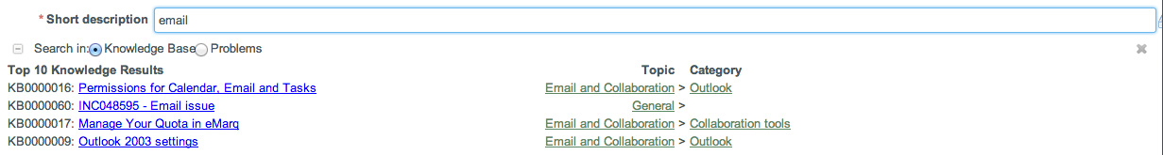
Short description auto-search
1
2
1
3
4
When entering text in the “Short description” field, a “quick search” is automatically performed in Knowledge Base or the Problem table
Clicking a KB article link will open the article in another window
Clicking a Problem will open it in another window
Clicking on the attachment Icon will relate the problem to the incident

Slide 26
3. FUNCTIONAL ESCALATION
If the incident cannot be resolved by the Service Desk, the incident is re-assigned to the appropriate resolver group:
Step | In Service-Now
Update the incident status | Change “the Status” from “New” to “In progress”.
Assign the incident to the appropriate group | Search and select the appropriate assignment group and resolver.
 | email notification is sent to the assignment group or resolver (if selected).

Slide 27
4. INVESTIGATION & DIAGNOSIS
All actions performed to resolve the incident must be recorded in ServiceNow:
Step | In Service-Now
Document internal IT activities carried out | Update “Work notes (internal view)“ with activities undertaken to resolve the issue: these notes are not visible to the caller and users in the watch list.
Communicate updates to the user | Update “Additional comments (end-user view)“ with relevant status information: these notes are visible to the caller and users in the watch list.

Slide 28
5. RESOLUTION & RECOVERY
An incident can be considered resolved when the service has been restored and/or a solution (workaround) provided
Step | In Service-Now
Update the incident status | Change “Status” to “Resolved “.
Provide close code | Select the relevant “Close code”.
Document the resolution | Update the “Close notes” field with the resolution and save. email notification with the “Close notes” is sent to the caller and users in the watch list.

Slide 29
6. INCIDENT CLOSURE
An incident is closed automatically after 5 days if the caller has not provided any feedback on the incident resolution.

Slide 30
NOTIFICATIONS
External notification (Caller)
Name | Recipient(s) | Trigger
New incident | Caller & Watch List | Incident Creation
Incident commented | Caller & Watch List | New “Additional comment”
Incident resolved | Caller & Watch List | Status changed to “Resolved”
Internal notifications (Assignee or group)
Name | Recipient | Trigger
Incident assigned | Sent to the Assigned to or Assignment Group | Incident assigned to a group and/or assignee.
Incident commented | Sent to the Assigned to or Assignment Group | Comment added by the caller or by a member of the watchlist.
Work note added | Sent to the Assigned to or Assignment Group / and to the Work note List | Work notes added.
Rules for internal notifications: Never sent to the “Event creator”. For example if Joe ITIL assign an incident to himself, or add a work note to an incident he owns, he will not be notified. Sent to the Assignment Group if Assigned to is blank. Otherwise sent only to Assigned to.

Slide 31
Additional Functionalities

Slide 32
Additional Functionalities
Service Level Management

Slide 33
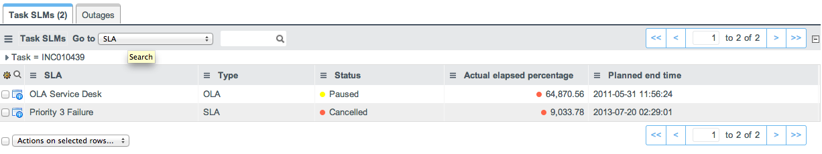

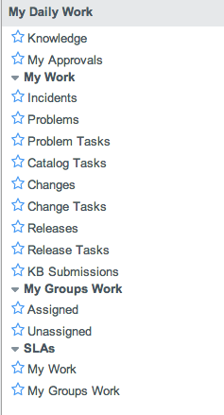
Task SLMs
1
2
The “Task SLMs” related displays the Service Level Commitments/targets instantiated for the current Incident.
The closest resolution target is always copied in the “SLA resolution due date” field.
Modules in “My Daily Work” application allows to see tasks along with their Service Level Commitments/targets
3

Slide 34
Additional Functionalities
Outage Management

Slide 35
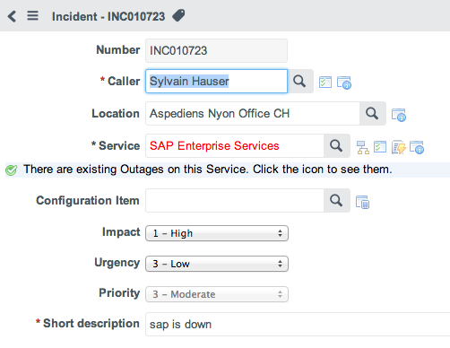
Outage DETECTION
When the selected Service or CI has ongoing outages, the field content is highlighted in red and an informational message is displayed below the field.
The Show Outage decoration icon also appears in order to look up the ongoing outages on the impacted Service or CI.
2
1

Slide 36
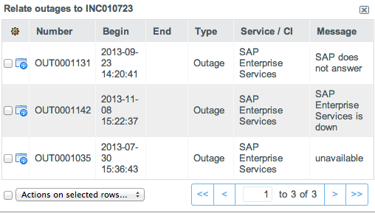
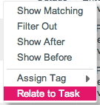
Outage look up and relate
2
2
1
2
Clicking the Show Outage button displays a list of ongoing outages on the impacted Service or CI
Right-click on an Outage and select “Relate to Task” in the contextual menu to relate the selected Outage with the current Incident.
Multiple outages can be related to the current Incident at once using the left selection checkboxes and the drop down action list.

Slide 37
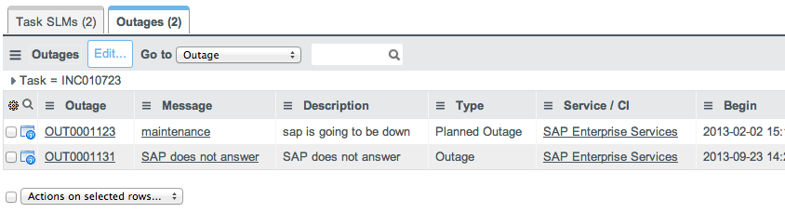
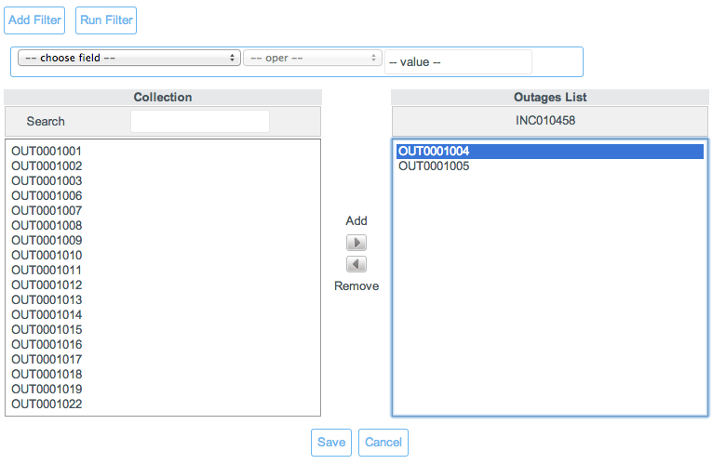
Related Outages
1
Related Outages are displayed in the “Outages” related list at the bottom of the Incident form
Use the “Edit” button to relate the current Incident to other existing Outage(s)
Use the slushbucket interface to add or remove related Outages to/from the current Incident
2

Slide 38
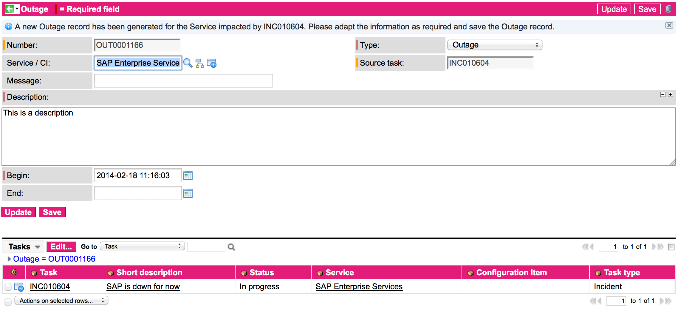
Outage creation
Outages can also be created directly from an Incident form
Right-click on the Incident form header bar and select “Create Outage” in the contextual menu
A pre-filled outage record is created using the Impacted Service.
The created outage is automatically related to the originating Incident.

Slide 39
Additional Functionalities
Parent-Child Relationship

Slide 40

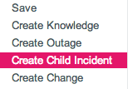
Parent-child relationship
1-to-Many relationship
A Parent Incident can have several Child Incidents
A Child Incident can only have one Parent Incident
1-level relationship
A Parent Incident cannot have another Parent Incident
A Child Incident cannot have other Child Incidents
Establishing the Parent-Child relationship
Child Incidents can be created from the Parent Incident form.
right click on header → “Create Child Incident” → creates a Child Incident based on the current Parent Incident attributes
Child Incident can be related to a Parent Incident via the “Parent incident” field on the Child Incident form

Slide 41
Parent-Child synchronized fields
Parent and Child Incidents have the following fields synchronized:
Service
Configuration Item
Impact
Urgency
State
Waiting for
Assignment group
Assigned to
Category
Subcategory
Problem number
Change Number
Caused by Change
External Reference
Short description
Description
Close code
Close notes

Slide 42

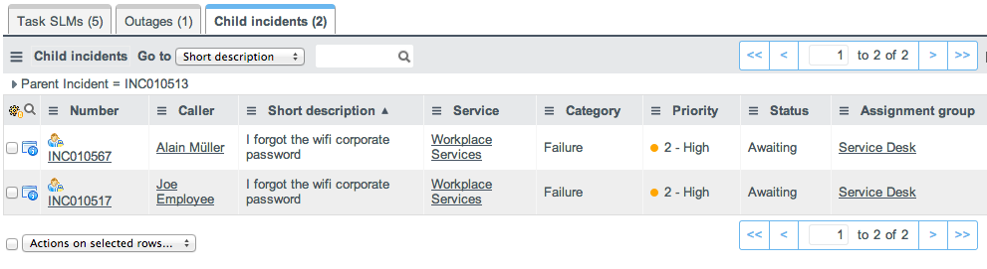
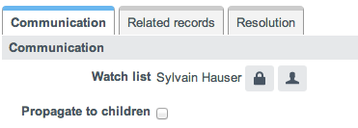
Parent Incident behaviour
A Parent Incident has the icon in its number field, and will have the following differentiating fields on its form:
A “Child Incident count” field
A “Child Incidents” related list
“Propagate to Children” field in the communication section
All updates on synchronized fields on the parent Incident are automatically propagated to Child Incidents.
When the “Propagate to Children” flag is selected, all submitted additional comments or Work notes are automatically propagated to Child Incidents.
N.B: The “Propagate to Children” flag is always resetted after submission
1
2
3

Slide 43
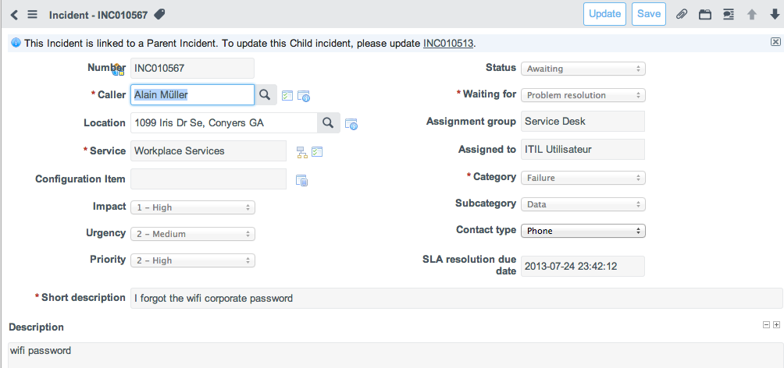
cHILD Incident behaviour
As soon as an Incident is related to a Parent Incident, synchronized field values of the Parent Incident are automatically copied onto the Child Incident.
On Child Incident, a message will indicate that the Incident is linked to a Parent Incident, therefore updates needs to be made on the Parent Incident
All synchronized fields are locked on the Child Incident form.
Child Incidents are therefore identified with the icon in its number field.
It is however possible to independently add Comments and Work notes on Child Incidents

Slide 44
Parent Incident resolution
When resolving a parent Incident, all Child Incidents are automatically resolved likewise (due to the field synchronization)
Child Incidents being resolved via through their Parent Incident will have a specific work note added mentioning the automatic resolution.

Slide 45
Exercises

Slide 46
Exercise 1 - Create new incident
Log a new incident as a Service Desk agent
Log in as ITIL User
Caller : “Joe Employee”
Business Service : “Infrastructure Services”
Impact & Urgency : “High” & “Low”
Contact type : “Phone”
Category : “Failure”
Short description : “Email not available”

Slide 47
Exercise 2 – Review incident
As ITIL User review the incident
Log in as ITIL User
Open incident created previously
Check impacted Business Service & CI depending on short description
Review Impact & Urgency, knowing the incident is the only one reported at this time
Assign the relevant Group

Slide 48
Exercise 3 – Resolve incident
Resolve the incident
Log in as ITIL Use
Open incident reviewed previously
Resolve the incident
Set Close code and Close notes knowing the incident has been solved by rebooting the user workstation

Slide 49
THANK YOU

